Slide 1

FACULTY OF INFORMATION TECHNOLOGY
Fall,20202017
MAT 207- LINEAR ALGEBRA
Lecture 3 – Matrix Algebra
05/01/2022
Lecture 3 : Matrix Algebra
1

Slide 2
Content
1
Matrix Algebra
2
The Inverse of Matrix
3
Characterizations of Invertibles Matrices
4
Partitioned Matrices( leave )
05/01/2022
Lecture 2 : Linear Equation in Linear Algebra
2

Slide 3
3.1 Matrix Algebra
05/01/2022
Lecture 3: Matrix Algebra
1
Notes:
3

Slide 4
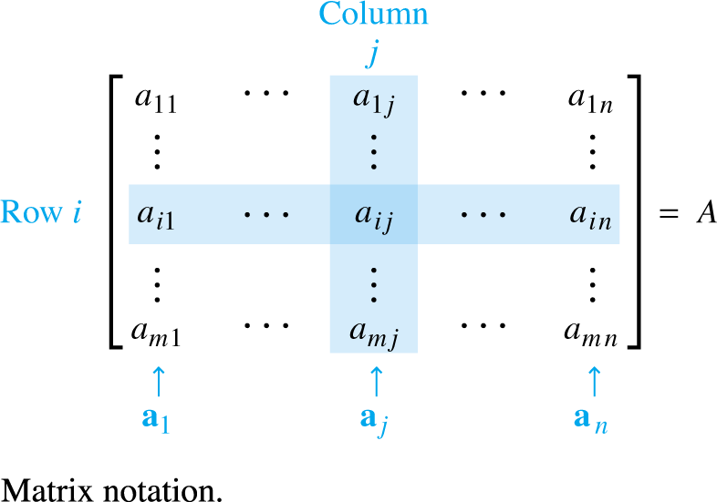

Matrix operations
If A is an matrix—that is, a matrix with m rows and n columns—then the scalar entry in the i-th row and j-th column of A is denoted by a_{ij} and is called the (i, j)-entry of A.
Each column of A is a list of m real numbers, which identifies a vector in $ℝ^{m}$.
05/01/2022
Lecture 3: Matrix Algebra
1
Notes:
4

Slide 5
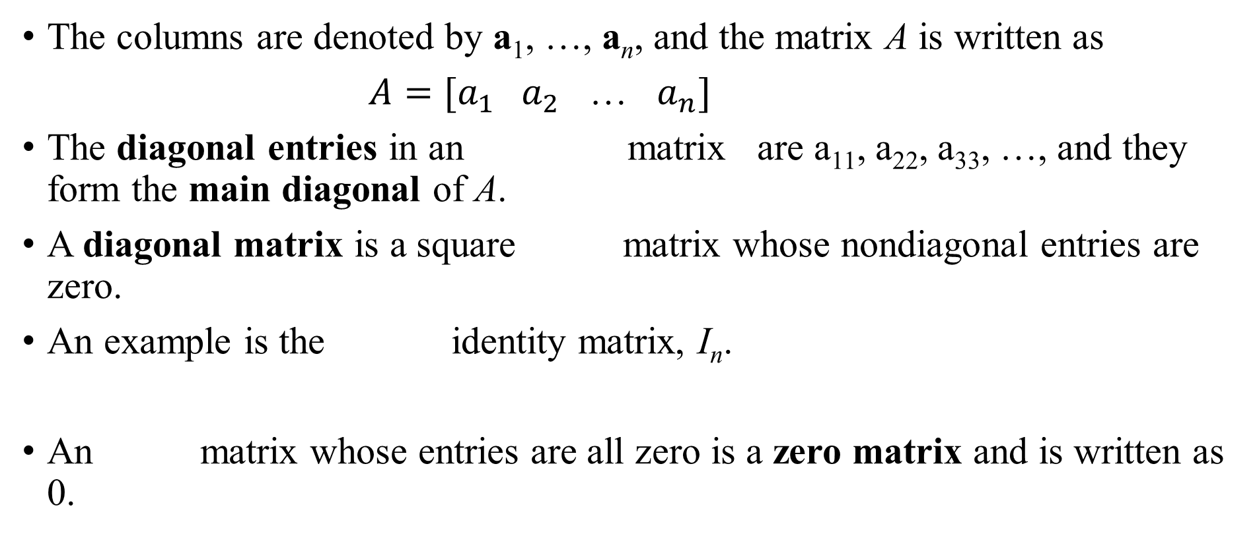
Matrix Operations
The columns are denoted by a₁, …, a_{n}, and the matrix A is written as
$A=[a_{1} a_{2}$ … $a_{n}]$
The diagonal entries in an matrix are a₁₁, a₂₂, a₃₃, …, and they form the main diagonal of A.
A diagonal matrix is a square matrix whose nondiagonal entries are zero.
An example is the identity matrix, I_{n}.
An matrix whose entries are all zero is a zero matrix and is written as 0.
05/01/2022
Lecture 3: Matrix Algebra
1

Slide 6
SUMS AND SCALAR MULTIPLES
If A and B are matrices, then the sum is the matrix whose columns are the sums of the corresponding columns in A and B.
The sum is defined only when A and B are the same size.
Example 1: Let and
Find and
05/01/2022
Lecture 3: Matrix Algebra
1

Slide 7
SUMS AND SCALAR MULTIPLES
Solution:
but is not defined because A and C have
different sizes.
If r is a scalar and A is a matrix, then the scalar multiple rA is the matrix
whose columns are r times the corresponding columns in A.
05/01/2022
Lecture 3: Matrix Algebra
1

Slide 8
SUMS AND SCALAR MULTIPLES
Theorem 1: Let A, B, and C be matrices of the same size, and let r and s be scalars.
b.
c.
d.
e.
f.

Slide 9
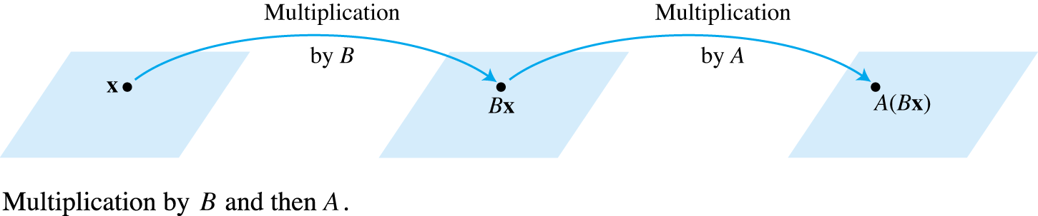
MATRIX MULTIPLICATION
When a matrix B multiplies a vector x, it transforms x into the vector Bx.
If this vector is then multiplied in turn by a matrix A, the resulting vector is A(Bx). See the Fig. 2 below.
Thus A (Bx) is produced from x by a composition of mappings—the linear transformations.

Slide 10
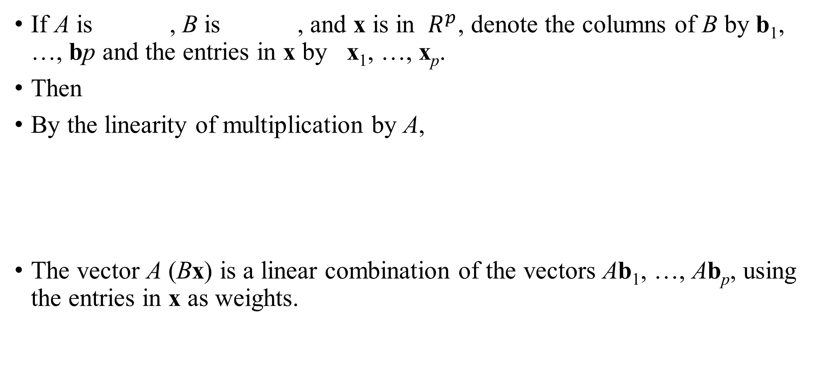
MATRIX MULTIPLICATION
If A is , B is , and x is in $R^{p}$, denote the columns of B by b₁, …, bp and the entries in x by x₁, …, x_{p}.
Then
By the linearity of multiplication by A,
The vector A (Bx) is a linear combination of the vectors Ab₁, …, Ab_{p}, using the entries in x as weights.

Slide 11

MATRIX MULTIPLICATION
In matrix notation, this linear combination is written as
Example : Compute AB, where and $B=\left[\begin{matrix}4 & 3 6 \\ 1 & −2 3\end{matrix}\right].$
Solution : Write and compute

Slide 12
MATRIX MULTIPLICATION

Slide 13
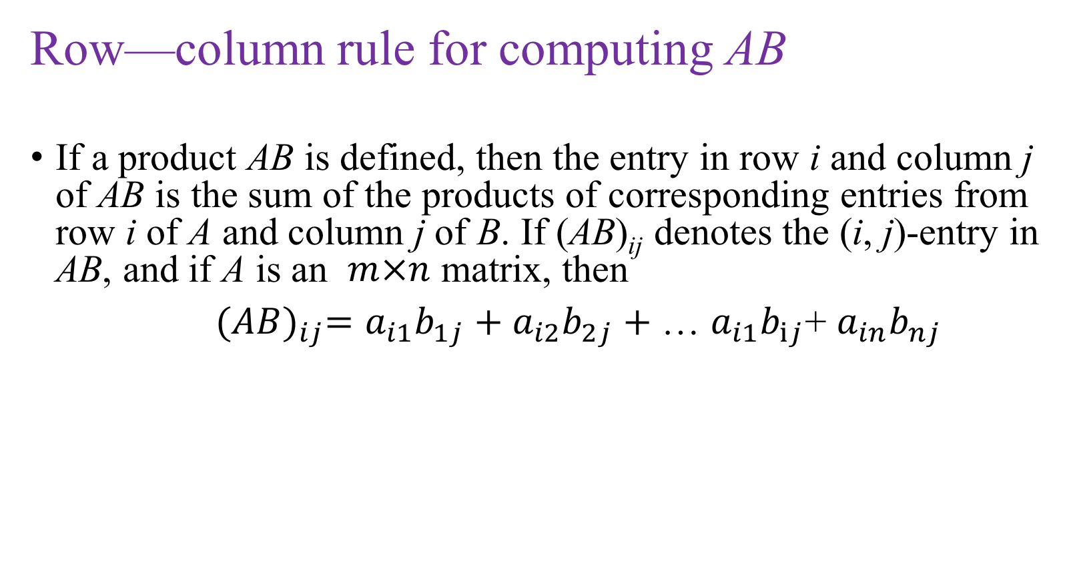
Matrix multiplication
Row—column rule for computing AB
If a product AB is defined, then the entry in row i and column j of AB is the sum of the products of corresponding entries from row i of A and column j of B. If (AB)_{ij} denotes the (i, j)-entry in AB, and if A is an $m×n$ matrix, then
${(AB)}_{ij}=a_{i1}b_{1j}+a_{i2}b_{2j}+$ … $a_{i1}b_{ij}$+ $a_{in}b_{nj}$

Slide 14
PROPERTIES OF MATRIX MULTIPLICATION
Theorem 2: Let A be an matrix, and let B and C have sizes for which the indicated sums and products are defined.
(associative law of multiplication)
(left distributive law)
(right distributive law)
for any scalar r
(identity for matrix multiplication)

Slide 15
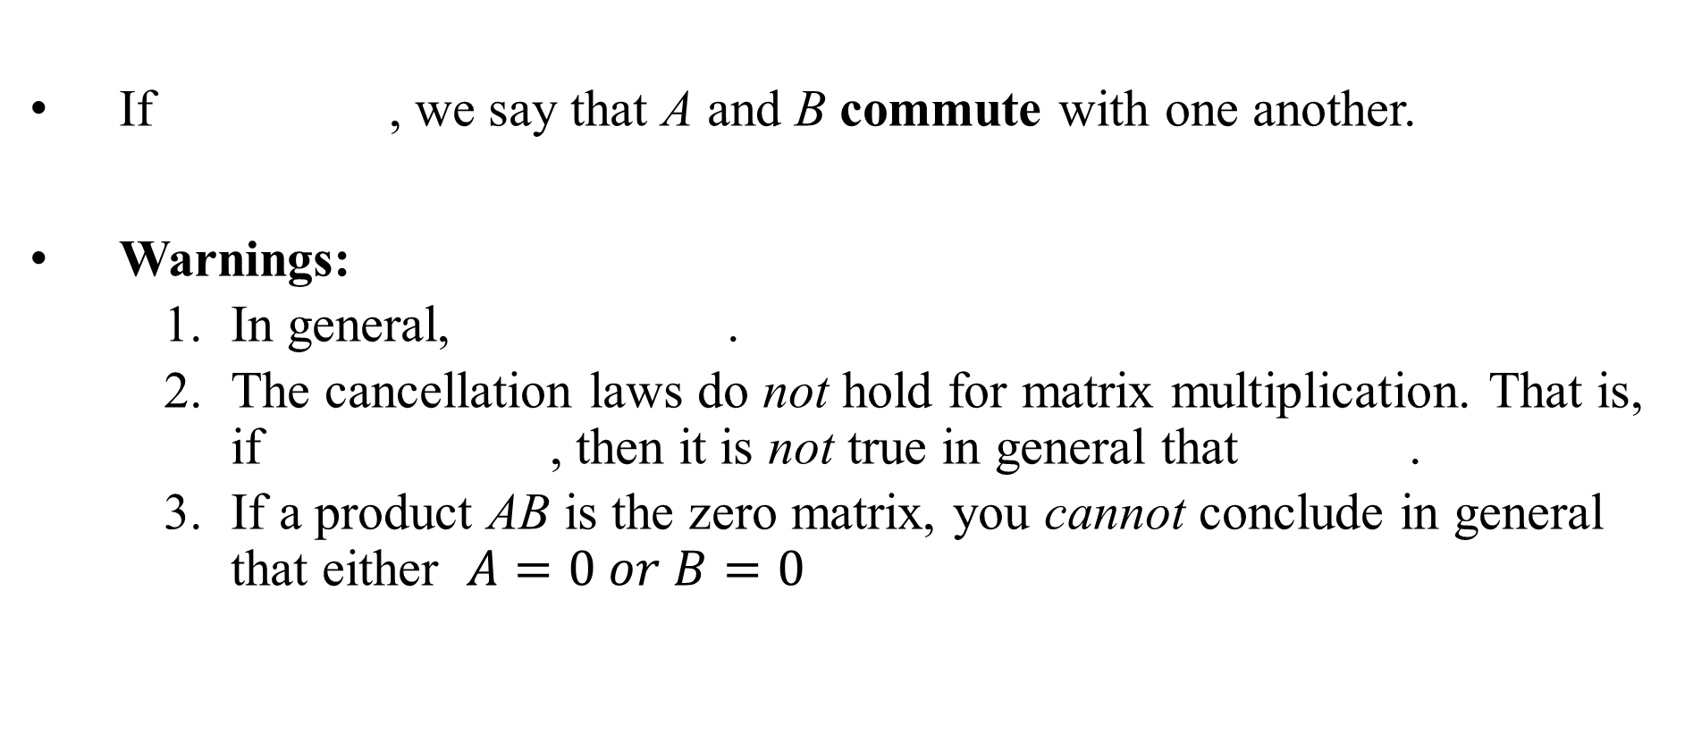
PROPERTIES OF MATRIX MULTIPLICATION
If , we say that A and B commute with one another.
Warnings:
In general, .
The cancellation laws do not hold for matrix multiplication. That is, if , then it is not true in general that .
If a product AB is the zero matrix, you cannot conclude in general that either $A=0 or B=0$
Notes:
15

Slide 16
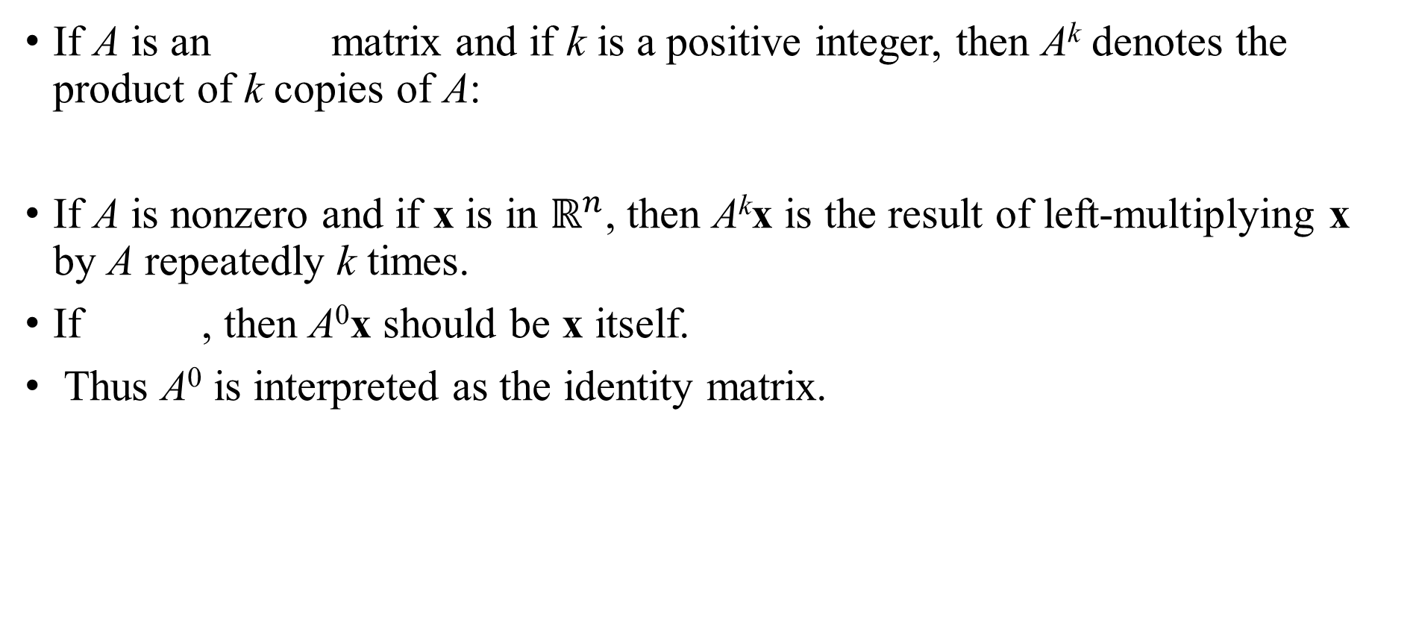
POWERS OF A MATRIX
If A is an matrix and if k is a positive integer, then A^{k} denotes the product of k copies of A:
If A is nonzero and if x is in $ℝ^{n}$, then A^{k}x is the result of left-multiplying x by A repeatedly k times.
If , then A⁰x should be x itself.
Thus A⁰ is interpreted as the identity matrix.

Slide 17
THE TRANSPOSE OF A MATRIX
Given an matrix A, the transpose of A is the matrix, denoted by A^{T}, whose columns are formed from the corresponding rows of A.
Theorem 3: Let A and B denote matrices whose sizes are appropriate for the following sums and products.
For any scalar r,

Slide 18
3.2 The Inverse of Matrix

Slide 19
MATRIX OPERATIONS
An matrix A is said to be invertible if there is an matrix C such that
and
where , the identity matrix.
In this case, C is an inverse of A.
In fact, C is uniquely determined by A, because if B were another inverse of A, then
This unique inverse is denoted by , so that
and

Slide 20
MATRIX OPERATIONS
Theorem 4 : Let . If , then A is invertible
and
If then A is not invertible
The quantity is called the determinant of A, and we write

Slide 21
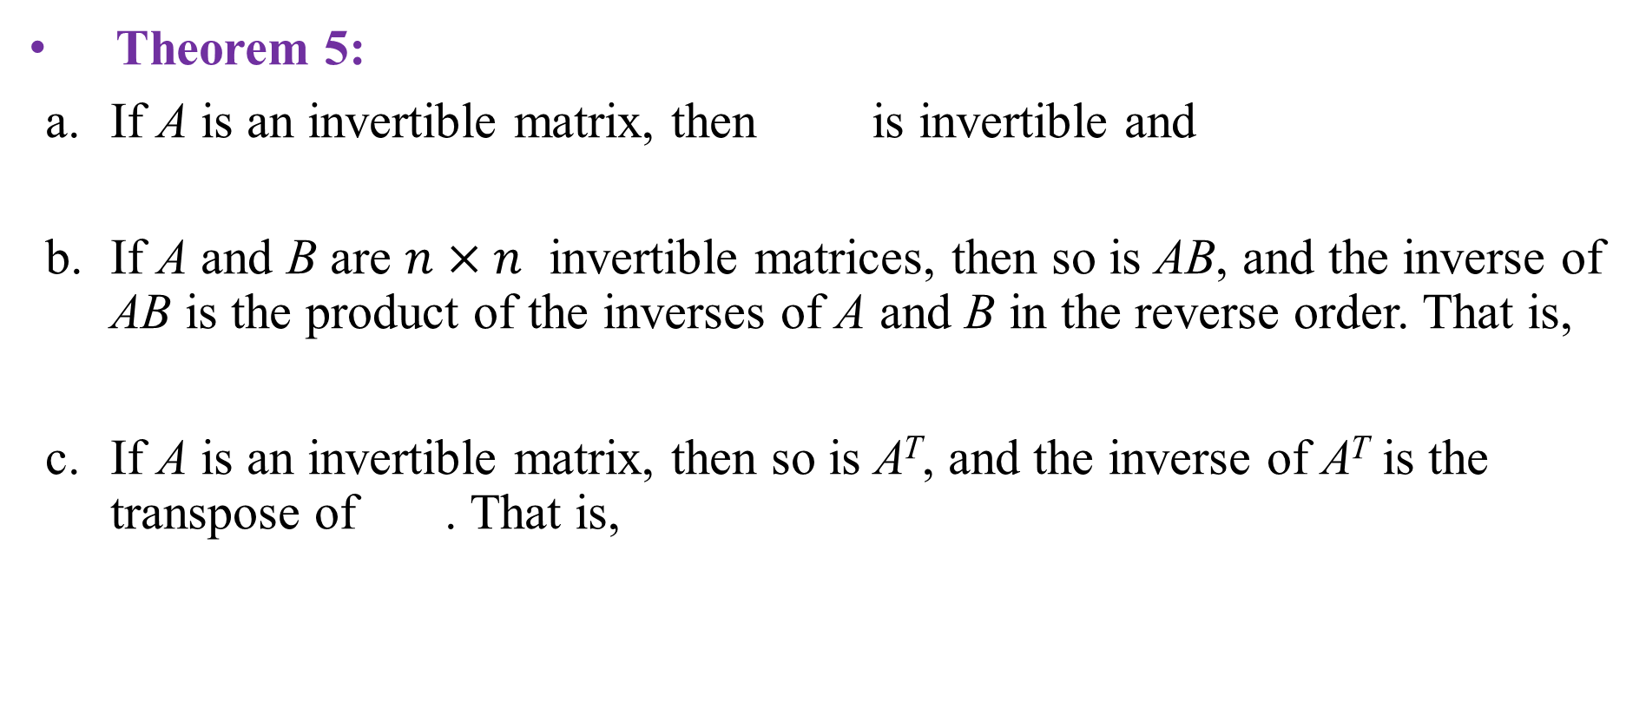
MATRIX OPERATIONS
Theorem 5:
If A is an invertible matrix, then is invertible and
If A and B are $n×n$ invertible matrices, then so is AB, and the inverse of AB is the product of the inverses of A and B in the reverse order. That is,
If A is an invertible matrix, then so is A^{T}, and the inverse of A^{T} is the transpose of . That is,

Slide 22
MATRIX OPERATIONS
Theorem 6: An n x n matrix A is invertible if and only if A is row equivalent to I_{n}, and in this case, any sequence of elementary row operations that reduces A to I_{n} also transforms I_{n} into .

Slide 23
ALGORITHM FOR FINDING A⁻¹
Row reduce the augmented matrix . If A is row equivalent to I, then is row equivalent to . Otherwise, A does not have an inverse.
Example : Find the inverse of matrix
, if it exists.
Solution :

Slide 24
ALGORITHM FOR FINDING A⁻¹

Slide 25

ALGORITHM FOR FINDING A⁻¹
Theorem 6 shows, since $A\sim I$ , that A is invertible, and
Now, check the final answer.

Slide 26
2.3 CHARACTERIZATIONS OF
INVERTIBLE MATRICES

Slide 27
THE INVERTIBLE MATRIX THEOREM
Theorem 8: Let A be a square matrix. Then the following statements are equivalent. That is, for a given A, the statements are either all true or all false.
A is an invertible matrix.
A is row equivalent to the identity matrix.
A has n pivot positions.
The equation has only the trivial solution.
The columns of A form a linearly independent set.

Slide 28
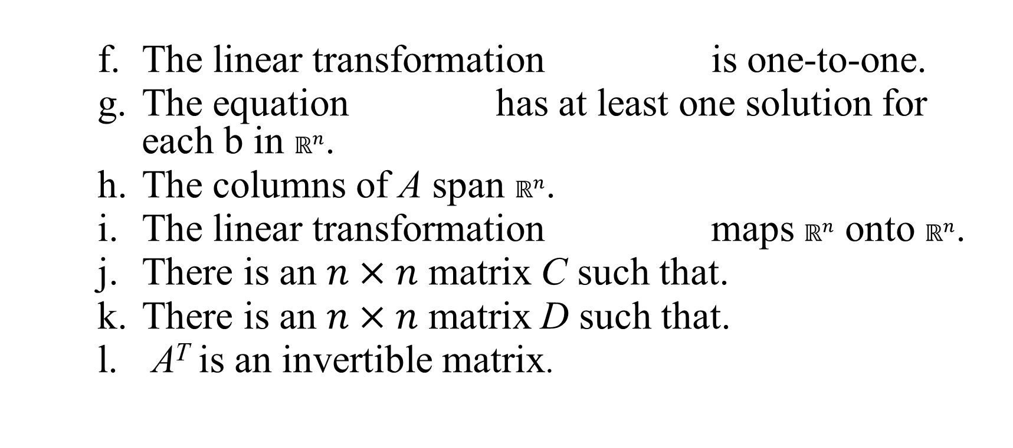
THE INVERTIBLE MATRIX THEOREM
The linear transformation is one-to-one.
The equation has at least one solution for each b in $ℝ^{n}$.
The columns of A span $ℝ^{n}$.
The linear transformation maps $ℝ^{n}$ onto $ℝ^{n}$.
There is an $n×n$ matrix C such that.
There is an $n×n$ matrix D such that.
A^{T} is an invertible matrix.

Slide 29
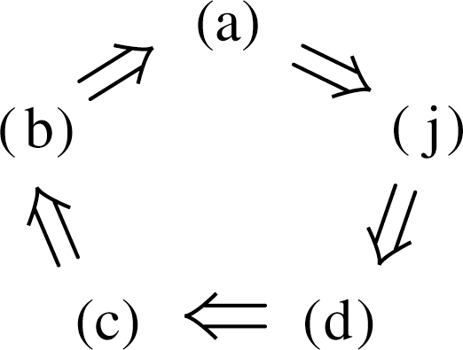
THE INVERTIBLE MATRIX THEOREM
The proof will establish the “circle” of implications as shown in the following figure.
If any one of these five statements is true, then so are the others.

Slide 30
THE INVERTIBLE MATRIX THEOREM
Example 1: Use the Invertible Matrix Theorem to decide if A is invertible:
Solution :

Slide 31
THE INVERTIBLE MATRIX THEOREM
So A has three pivot positions and hence is invertible, by the Invertible Matrix Theorem, statement (c).
The Invertible Matrix Theorem applies only to square matrices
For example, if the columns of a matrix are linearly independent, we cannot use the Invertible Matrix Theorem to conclude anything about the existence or nonexistence of solutions of equation of the form

Slide 32
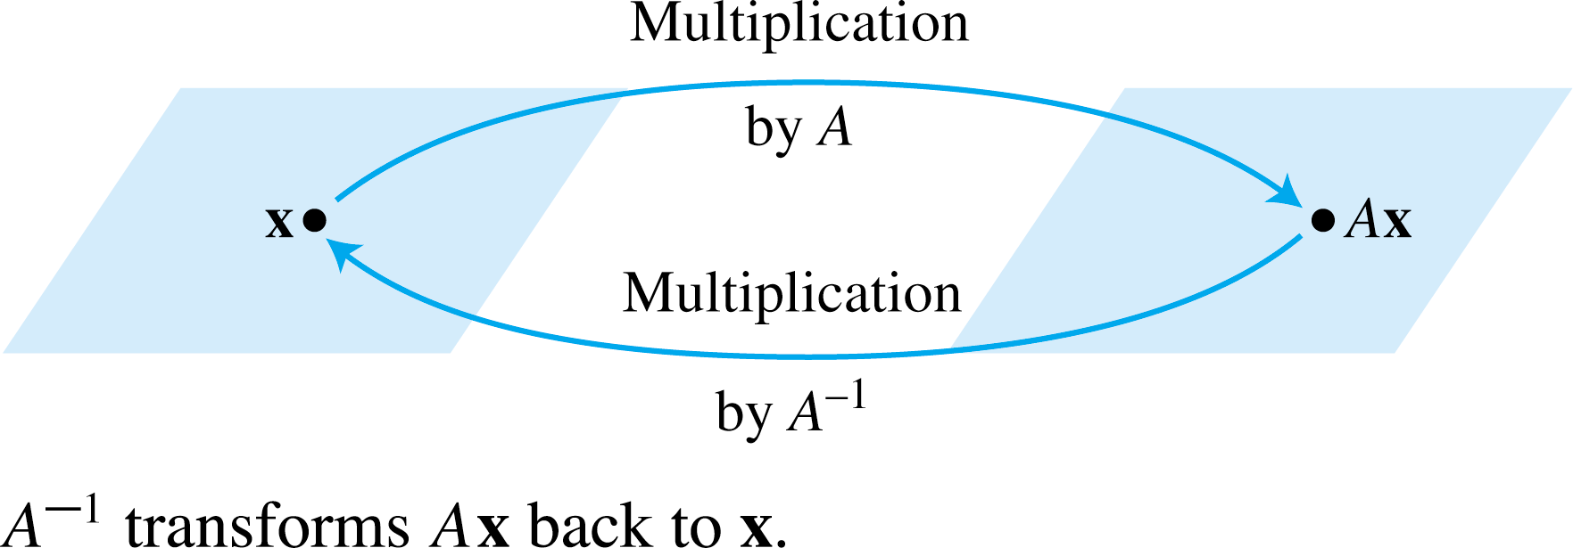
INVERTIBLE LINEAR TRANSFORMATIONS
When a matrix A is invertible, the equation can be viewed as a statement about linear transformations. See the following figure.

Slide 33
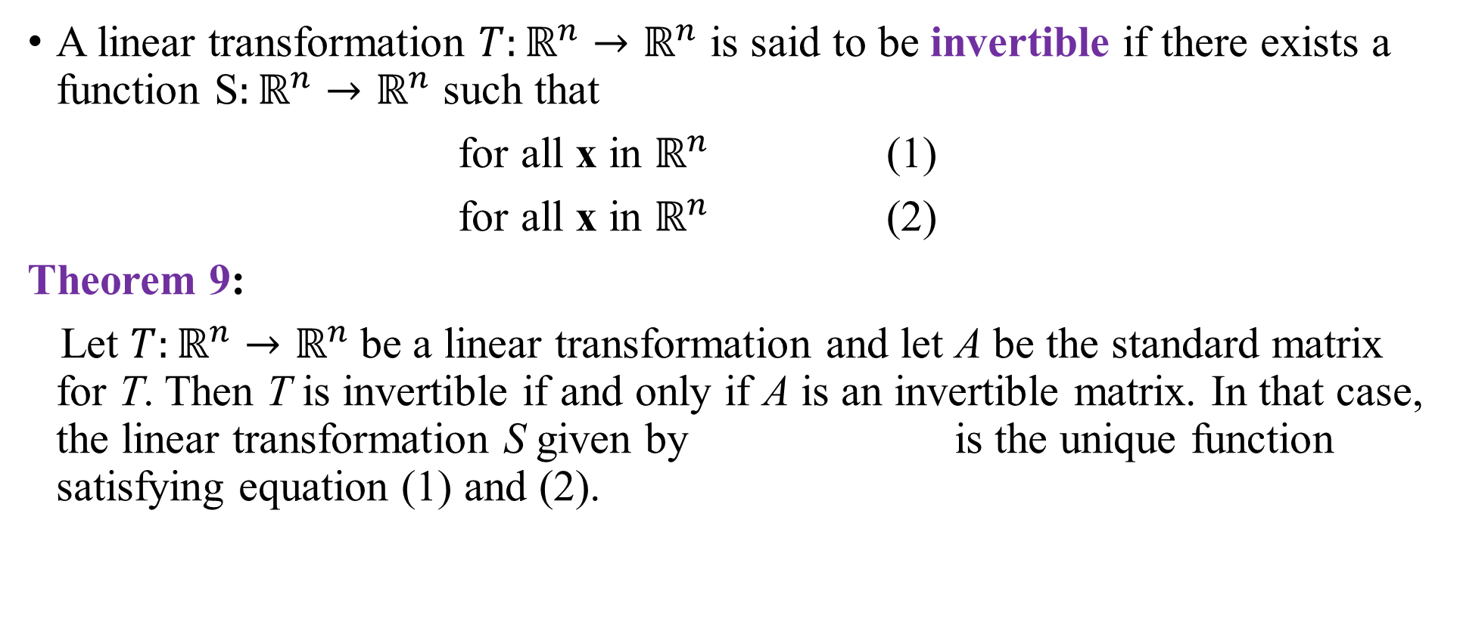
INVERTIBLE LINEAR TRANSFORMATIONS
A linear transformation $T:ℝ^{n}→ℝ^{n}$ is said to be invertible if there exists a function S$:ℝ^{n}→ℝ^{n}$ such that
for all x in $ℝ^{n}$ (1)
for all x in $ℝ^{n}$ (2)
Theorem 9:
Let $T:ℝ^{n}→ℝ^{n}$be a linear transformation and let A be the standard matrix for T. Then T is invertible if and only if A is an invertible matrix. In that case, the linear transformation S given by is the unique function satisfying equation (1) and (2).

Slide 34
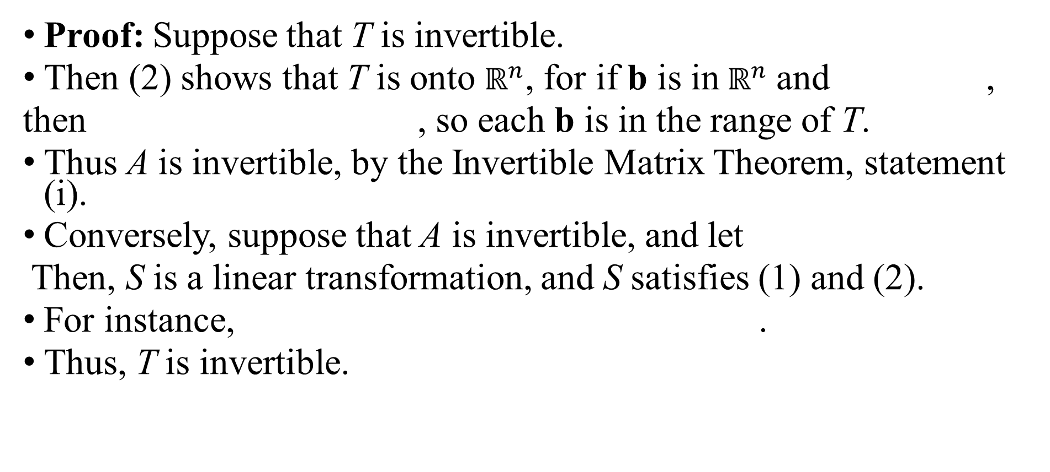
INVERTIBLE LINEAR TRANSFORMATIONS
Proof: Suppose that T is invertible.
Then (2) shows that T is onto $ℝ^{n}$, for if b is in$ℝ^{n}$ and ,
then , so each b is in the range of T.
Thus A is invertible, by the Invertible Matrix Theorem, statement (i).
Conversely, suppose that A is invertible, and let
Then, S is a linear transformation, and S satisfies (1) and (2).
For instance, .
Thus, T is invertible.

Slide 35
2.4 PARTITIONED MATRICES

Slide 36

PARTITIONED MATRICES
Example 1 : The matrix
Can also be written as the $2×3$partitioned (or block) matrix
Whose entries are the blocks (or submatrices)

Slide 37
ADDITION AND SCALAR MULTIPLICATION
If matrices A and B are the same size and are partitioned in exactly the same way, then it is natural to make the same partition of the ordinary matrix sum A + B.
In this case, each block of A + B is the (matrix) sum of the corresponding blocks of A and B.
Multiplication of a partitioned matrix by a scalar is also computed block by block.

Slide 38
MULTIPLICATION OF PARTITIONED MATRICES
Partitioned matrices can be multiplied by the usual row—column rule as if the block entries were scalars, provided that for a product AB, the column partition of A matches the row partition of B.
Example: Let
The 5 columns of A are partitioned into a set of 3 columns and then a set of 2 columns. The 5 rows of B are partitioned in the same way—into a set of 3 rows and then a set of 2 rows.

Slide 39
MULTIPLICATION OF PARTITIONED MATRICES
. It can be shown that the ordinary product AB can be written as
For instance
Hence

Slide 40
MULTIPLICATION OF PARTITIONED MATRICES
Theorem 10 : Column—Row Expansion of AB

Slide 41
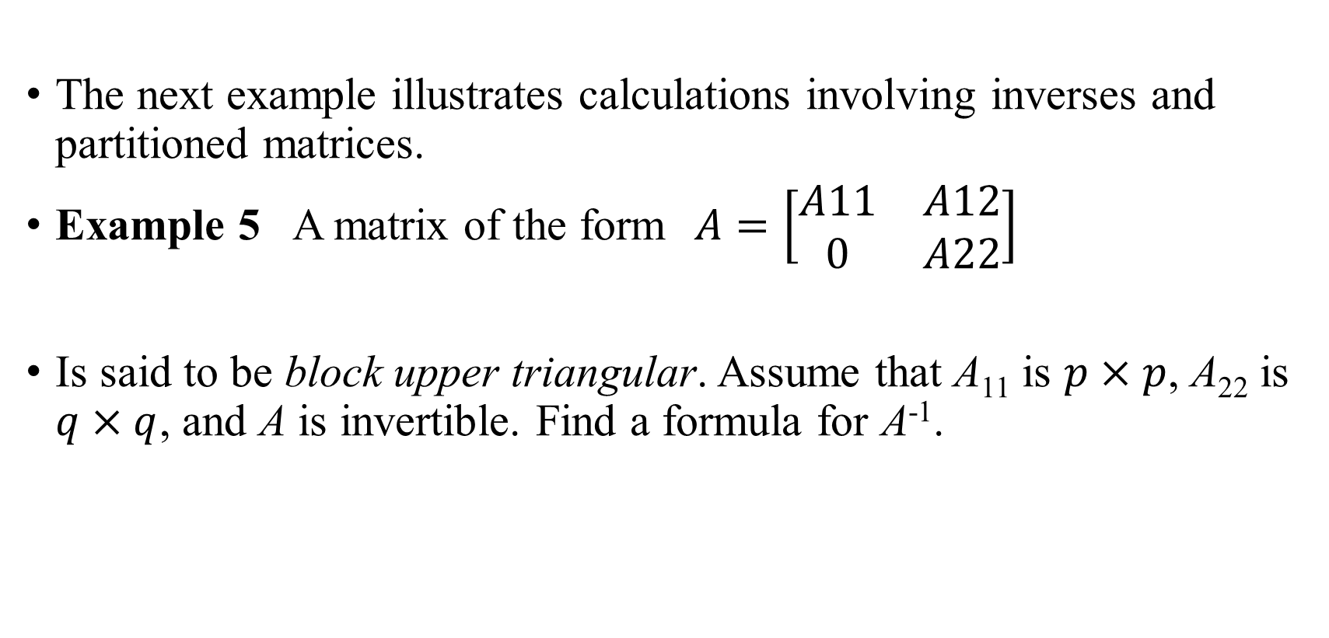
INVERSES OF PARTIONED MATRICES
The next example illustrates calculations involving inverses and partitioned matrices.
Example 5 A matrix of the form$A=\left[\begin{matrix}A11 & A12 \\ 0 & A22\end{matrix}\right]$
Is said to be block upper triangular. Assume that A₁₁ is $p×p$, A₂₂ is $q×q$, and A is invertible. Find a formula for A⁻¹.

Slide 42
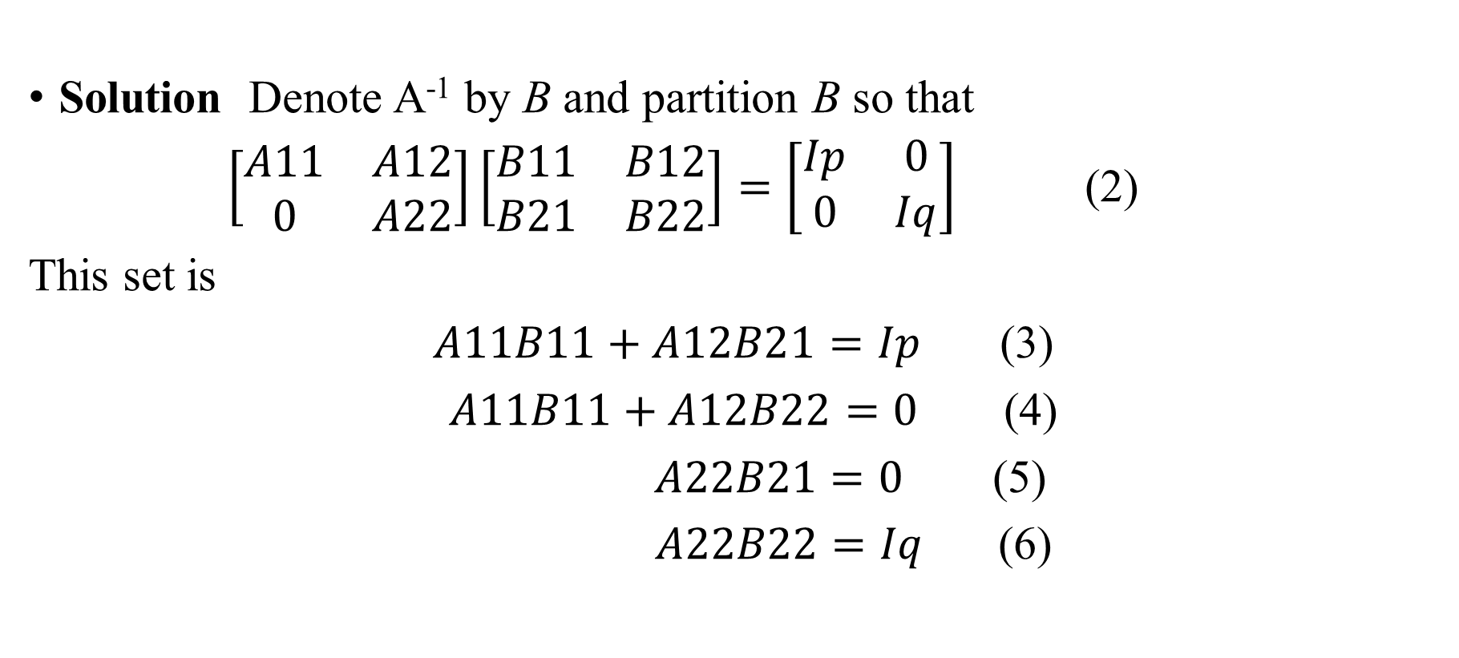
INVERSES OF PARTIONED MATRICES
Solution Denote A⁻¹ by B and partition B so that
$\left[\begin{matrix}A11 & A12 \\ 0 & A22\end{matrix}\right]\left[\begin{matrix}B11 & B12 \\ B21 & B22\end{matrix}\right]=\left[\begin{matrix}Ip & 0 \\ 0 & Iq\end{matrix}\right]$ (2)
This set is
$A11B11+A12B21=Ip$ (3)
$A11B11+A12B22=0$ (4)
$A22B21=0$ (5)
$A22B22=Iq$ (6)

Slide 43
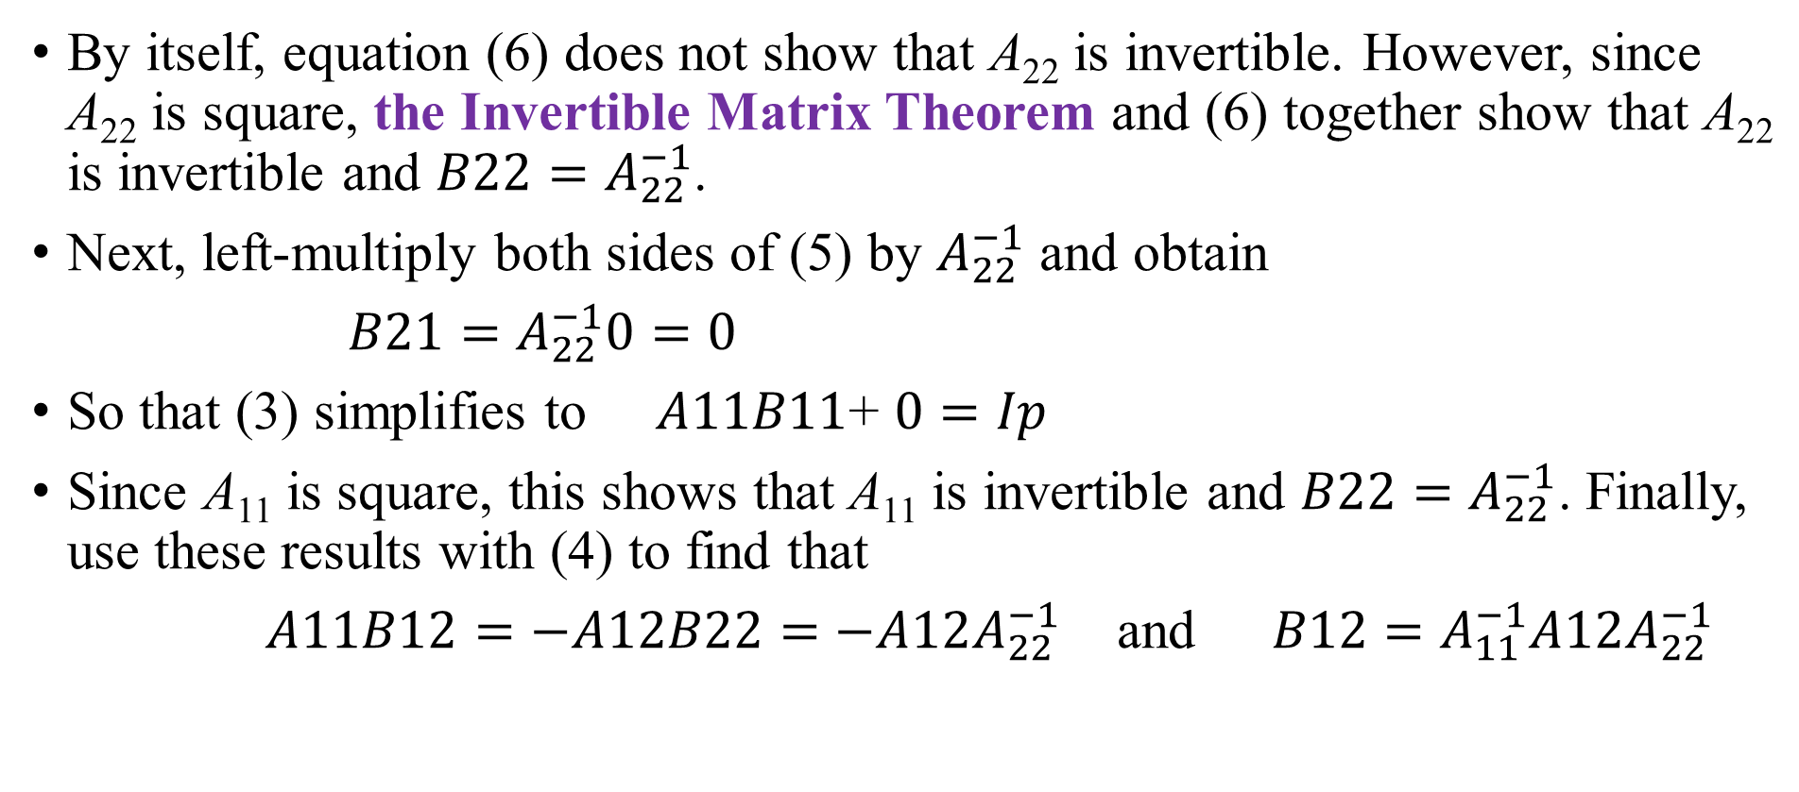
INVERSES OF PARTIONED MATRICES
By itself, equation (6) does not show that A₂₂ is invertible. However, since A₂₂ is square, the Invertible Matrix Theorem and (6) together show that A₂₂ is invertible and $B22=A_{22}^{−1}$.
Next, left-multiply both sides of (5) by $A_{22}^{−1}$ and obtain
$B21=$ $A_{22}^{−1}0=0$
So that (3) simplifies to $A11B11$+ $0=Ip$
Since A₁₁ is square, this shows that A₁₁ is invertible and $B22=A_{22}^{−1}$. Finally, use these results with (4) to find that
$A11B12=−A12B22=$ $−A12A_{22}^{−1}$ and $B12=A_{11}^{−1}A12A_{22}^{−1}$

Slide 44
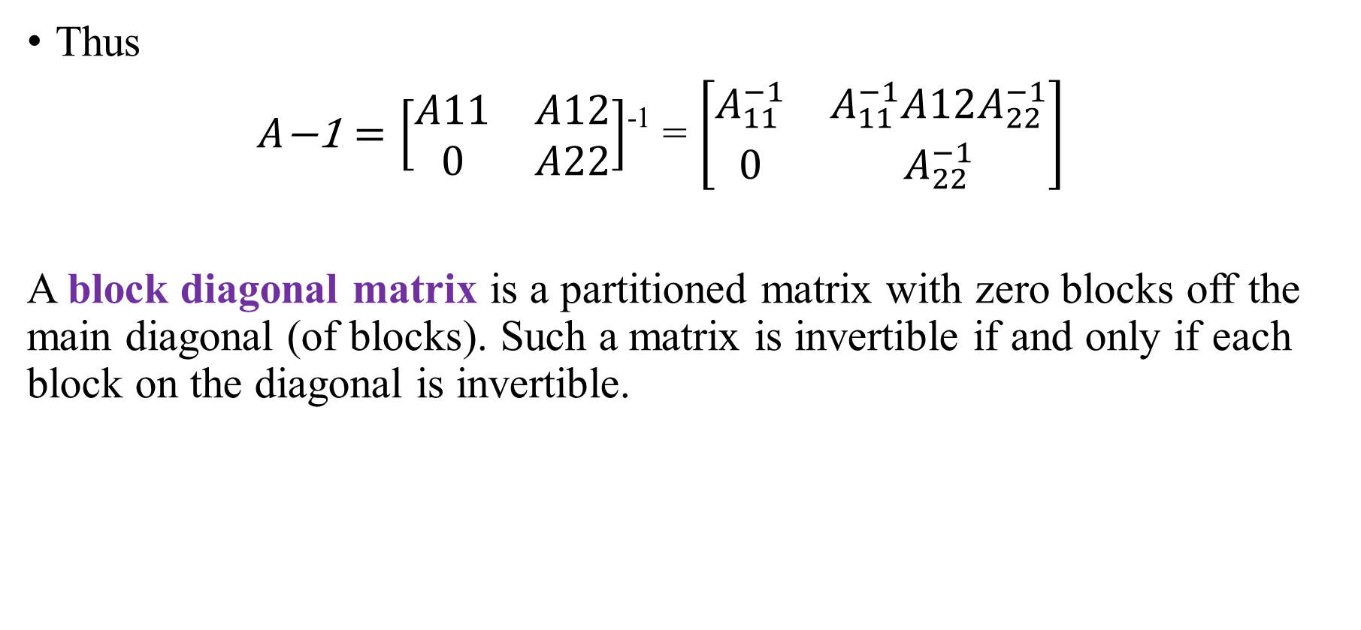
INVERSES OF PARTIONED MATRICES
Thus
$A\text{−1}=\left[\begin{matrix}A11 & A12 \\ 0 & A22\end{matrix}\right]$⁻¹ = $\left[\begin{matrix}A_{11}^{−1} & A_{11}^{−1}A12A_{22}^{−1} \\ 0 & A_{22}^{−1}\end{matrix}\right]$
A block diagonal matrix is a partitioned matrix with zero blocks off the main diagonal (of blocks). Such a matrix is invertible if and only if each block on the diagonal is invertible.

Slide 45
Thank you for listening

